Slide 1
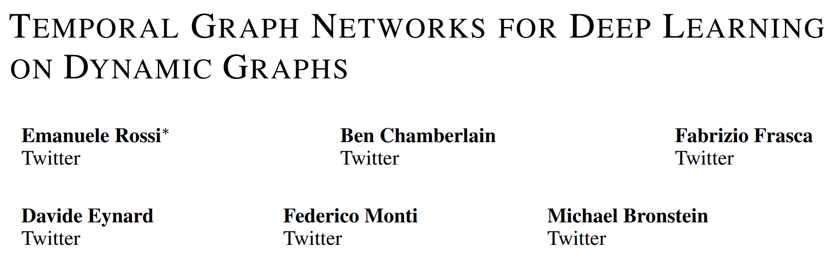
Deep Learning Assignment
TEMPORAL GRAPH NETWORKS FOR DEEP LEARNING
Group-14
Aditya Pant 2024PHXP0508G
Paritosh Kumar 2024PHXP0506G
Ashutosh Kumar 2024PHXP0505G
Ashwin Chougule 2024PHXP0510G
Sudipto Das 2024PHXP0504G
https://arxiv.org/pdf/2006.10637

Slide 2
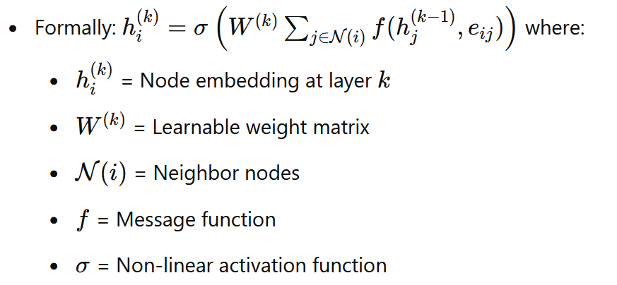
Working of Graph Neural Networks (GNNs)
Graph Representation:
A graph consists of nodes and edges.
Each node has features and edges have features .
Message Passing:
GNNs operate by iteratively exchanging information between nodes.
At each layer, nodes aggregate messages from their neighbors.
Graph-Level Representation:
After multiple layers, node embeddings are aggregated to form a graph-level representation.
Applications:
Node classification, link prediction, and graph classification.

Slide 3
Why exiting GNN fall short
Challenges
Solution
Nature - Static GNN
They assume a fixed graph structure.
They ignore temporal dynamics—when nodes and edges change over time.
This makes them unsuitable for real-world dynamic networks, like social media, transaction networks, or communication systems, where interactions evolve continuously.
Temporal Graph Networks (TGNs)
Designed to model dynamic, time-evolving graphs.
Use of self-attention mechanisms and functional time encoding to:
Capture time-dependent interactions.
Learn inductive representations that evolve with the graph.
Support real-time node classification and link prediction, even for unseen nodes.
What's Missing?
Time-awareness: Existing GNNs don't consider when interactions happen.
Inductive capability: They struggle to handle new nodes or future events without expensive retraining.
Efficient modeling of evolving patterns over time
Needed for Model
Captures both temporal and topological information.
Learns continuous-time dynamics rather than relying on discrete snapshots.
Provides inductive learning, generating embeddings for unseen nodes in real time
https://arxiv.org/abs/2002.07962

Slide 4
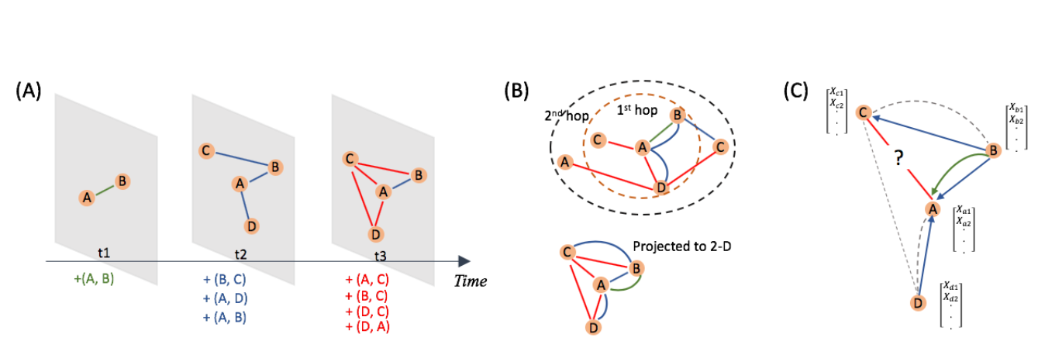
Introduction to Temporal Graphs
Temporal graphs are dynamic graphs where nodes, edges, and features change over time.
Examples:
Social Networks: Friendships, interactions, posts over time.
Financial Transactions: Payments, fraud detection, transaction graphs.
Network Traffic: Data packets, network congestion analysis.
Problem: Traditional GNNs fail to capture the evolving nature of data.

Slide 5
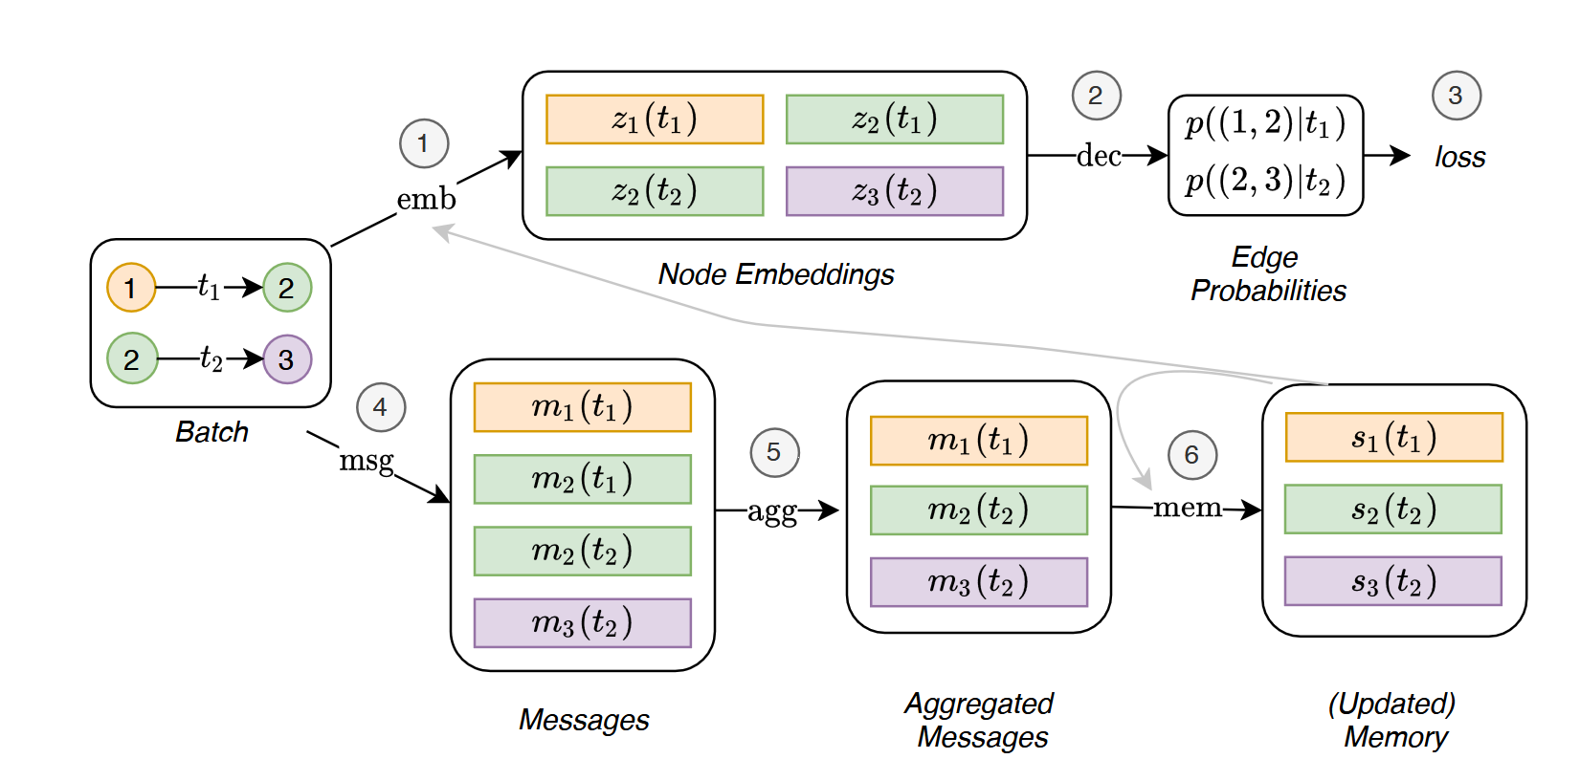
Message passing in TGN

Slide 6
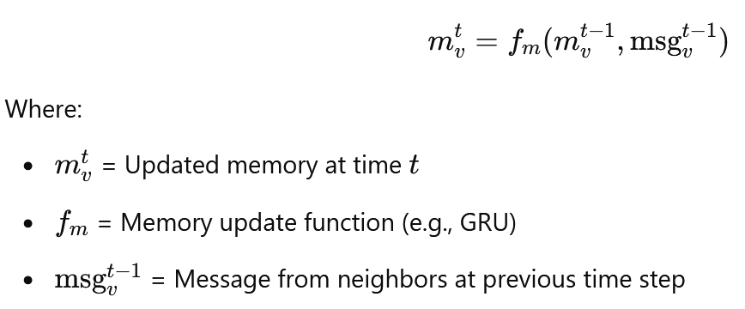
Time Aware Node and Link Embedding
Graph Representation:
Nodes represent routers or switches.
Edges represent physical or virtual links.
Each edge is associated with a timestamp indicating when the traffic data was captured.
Message Passing with Memory Updates:
Unlike GNNs, TGN maintains a time-aware memory for each node, capturing its historical behavior.
Nodes exchange messages containing both current traffic data and their memory states.
Memory updates occur using GRU (Gated Recurrent Unit) or LSTM (Long Short-Term Memory).
This allows TGN to model the temporal evolution of network states.
Mathematically:

Slide 7
GRU vs. LSTM
Aspect | GRU (Gated Recurrent Unit) | LSTM (Long Short-Term Memory) | Which is Better for TGN?
Architecture | Simpler with two gates (Update, Reset) | More complex with three gates (Input, Output, Forget) | GRU - Lower complexity makes it faster for large-scale graphs.
Memory Efficiency | Consumes less memory and computational resources | Higher memory consumption due to additional gates | GRU - More memory-efficient for dynamic graph updates.
Performance on Short-Term Data | Performs well for short-term dependencies | Can handle both short-term and long-term dependencies | LSTM - Better if the application has long-term patterns.
Training Time | Faster to train due to simpler architecture | Slower to train because of more parameters | GRU - Faster training for real-time applications.
Overfitting Tendency | Less prone to overfitting | More prone to overfitting with small datasets | GRU - Easier to regularize in sparse datasets.
Interpretability | Easier to interpret with fewer parameters | Harder to interpret due to complex interactions | GRU - Easier to debug and analyze in network scenarios.
Handling Sparse Data | Efficiently handles sparse, event-driven data | May struggle with sparse input data | GRU - Better for TGN as events are not continuous.
Temporal Graph Suitability | Well-suited for event-driven systems like network failures | Suitable for continuous time-series with frequent events | GRU - More efficient for dynamic networks with irregular updates.
When to Choose | Ideal for real-time, large-scale graphs | Preferable for applications needing long-term historical analysis | GRU - Best for T

Slide 8
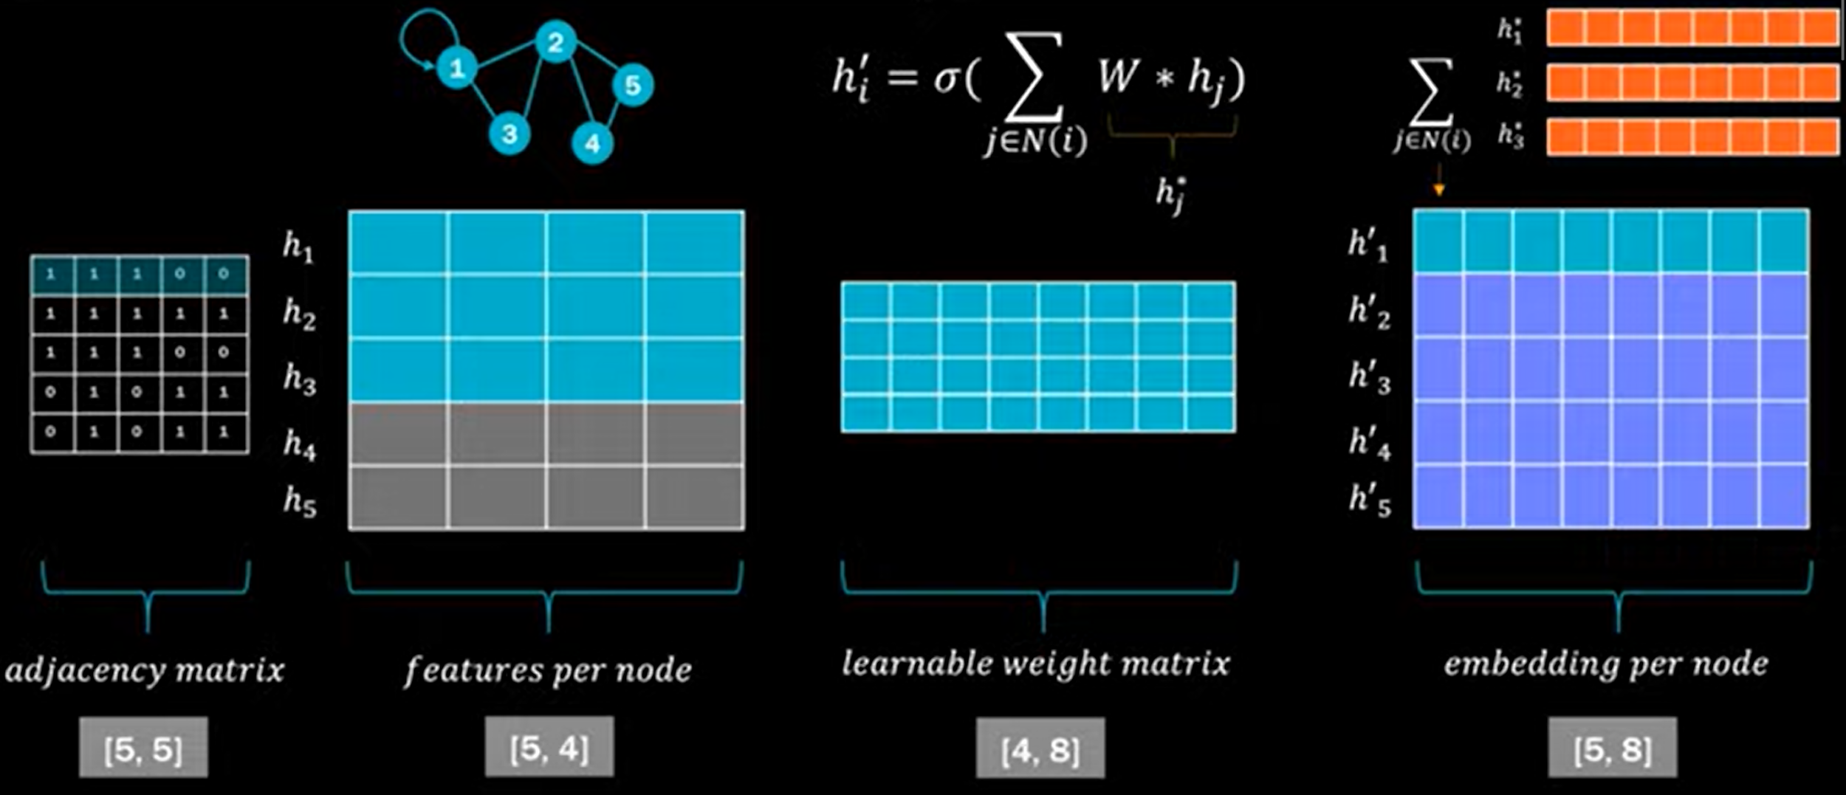
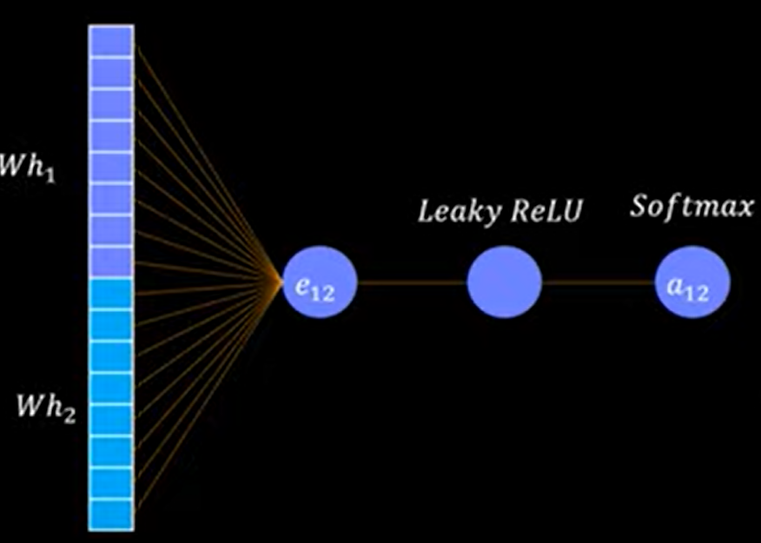
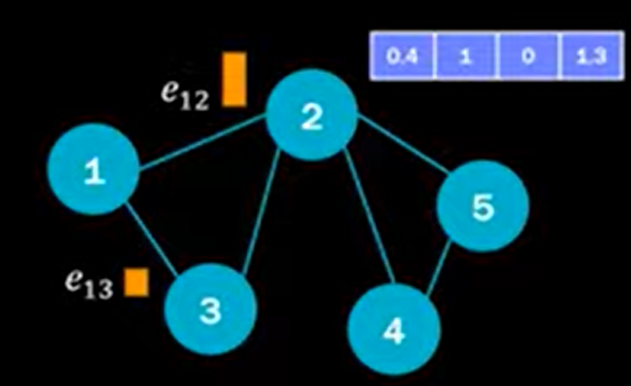
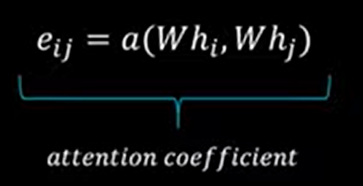
Attention Layer
Learning
Message Passing
Attention

Slide 9
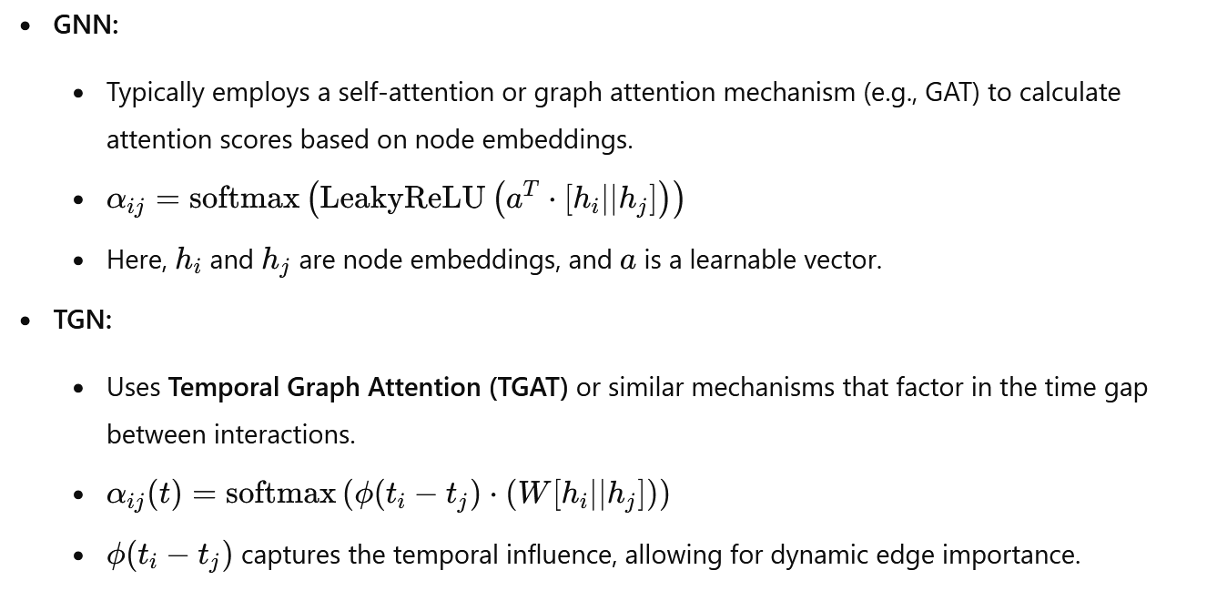
TGN Attention Layer

Slide 10
TGN Use-Cases
TGN (Temporal Graph Network) is widely used in scenarios where data evolves over time and understanding temporal patterns is essential. Some of the most popular use cases include:
Network Management and Load Balancing:
Predicts traffic congestion and reroutes data in large-scale IP networks.
Used for proactive fault detection and network optimization.
Fraud Detection in Financial Systems:
Monitors transaction patterns to detect anomalies and identify fraudulent behavior in real-time.
Social Network Analysis:
Tracks user interactions over time to recommend connections, detect communities, or predict user behavior.
Recommendation Systems:
Provides personalized recommendations on e-commerce platforms by analyzing user activity and temporal purchase patterns.
Healthcare Monitoring:
Analyzes patient data streams for early detection of diseases or predicting health deterioration.
Supply Chain Optimization:
Forecasts demand fluctuations and suggests efficient inventory management using historical data.
Cybersecurity:
Detects and responds to threats by analyzing abnormal behavior across networks over time.
Smart Transportation:
Predicts traffic patterns, suggests optimal routes, and manages autonomous vehicle networks using real-time and historical data.

Slide 11
Implementation and Demo

Slide 12
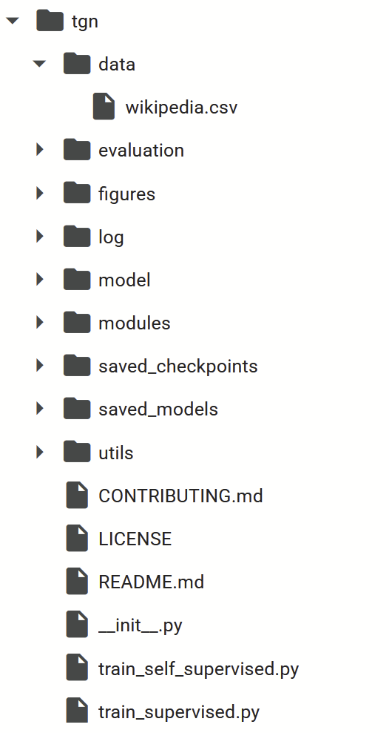
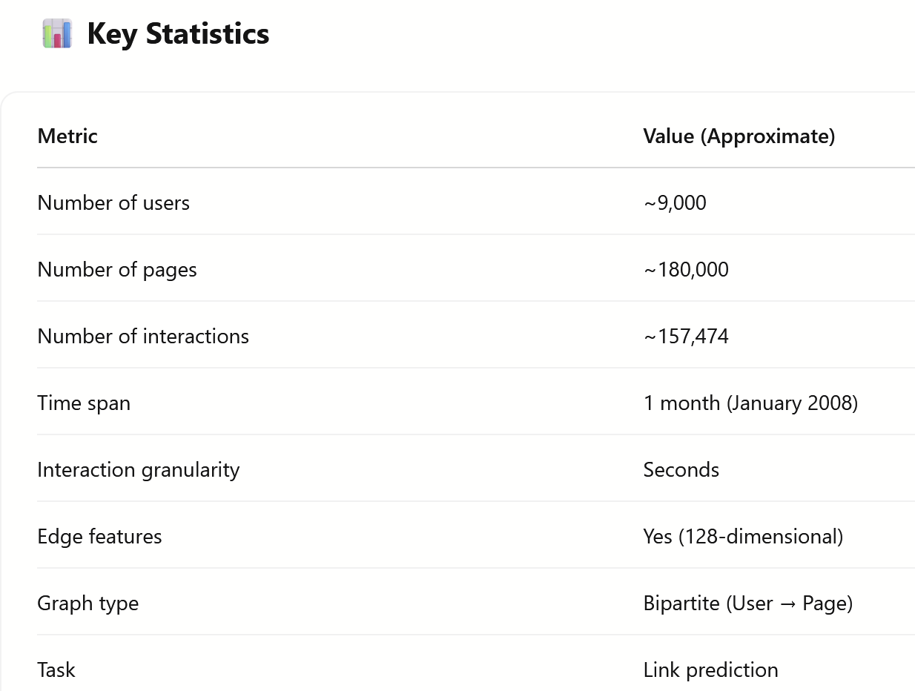
Dataset used in TGN Paper
Datasets
Original TGN paper uses following four datasets for the experiments.
Reddit , Wikipedia, MOOC ,LastFM
For our experiment, we took wikipedia data
https://github.com/twitter-research/tgn

Slide 13
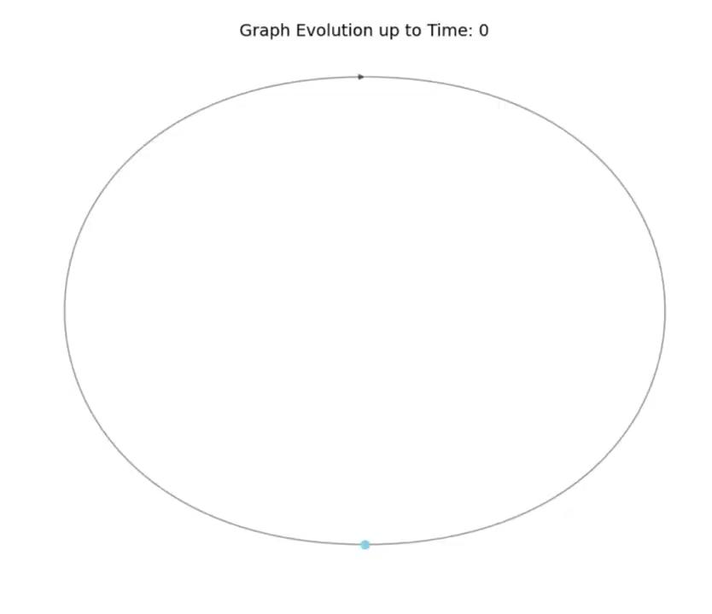
Overview of Interaction over time
Submitted: TGN_graph_animation.ipynb

Slide 14
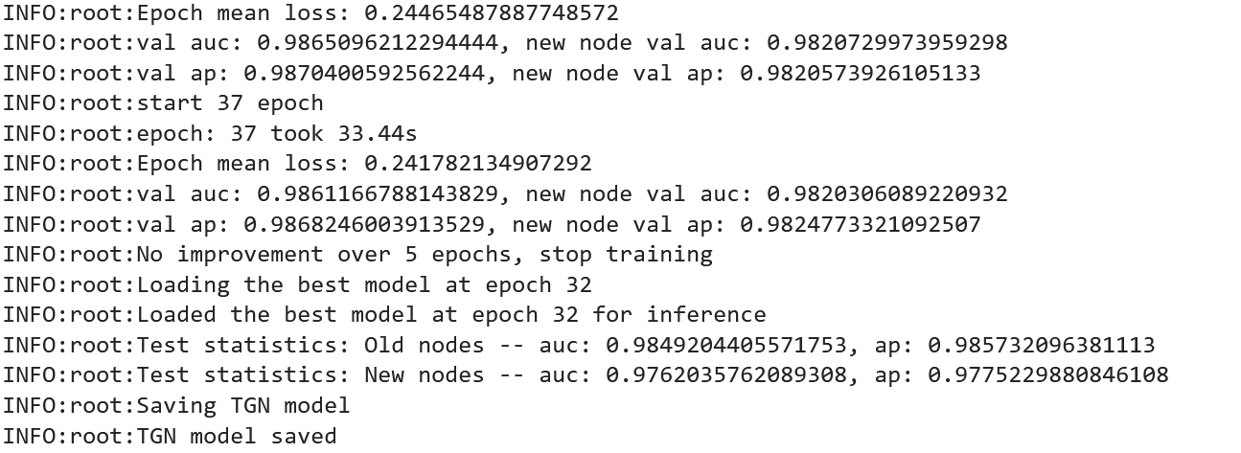
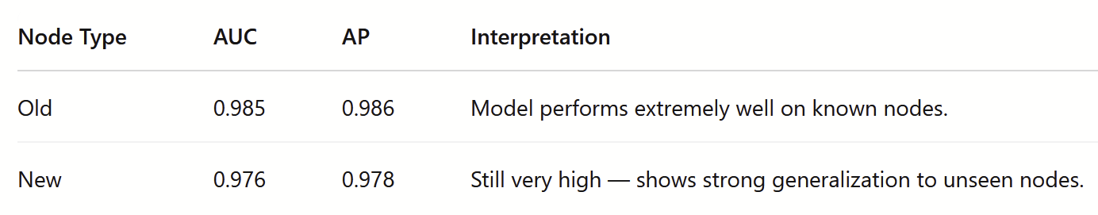
Training Process
Load the tgn git repository
Load wikipdia csv data, which is set of tensors for source, destination, edge features etc.
Pre-process data t- It takes raw .csv interaction logs and processes them to generate .npy (NumPy binary) files for faster access and efficient training.
!python3 utils/preprocess_data.py --data wikipedia --bipartite
Training options
train_self_supervised.py → self-supervised link prediction (temporal edge prediction)
!python3 train_self_supervised.py --use_memory --prefix tgn-attn --n_runs 10
train_supervised.py → supervised learning (e.g., edge classification)
Model is generated in model folder, downloaded the pth file.

Slide 15
Demo: Mini TGN Playground
Demo-1
https://huggingface.co/spaces/ashu316/tgn-playground
A simple gradio interface with:
A field for user ID
A field for page ID
A field for timestamp
Click “Predict”
Show:
Probability of the interaction happening
Demonstrate memory updation
Demo-2
https://huggingface.co/spaces/ashu316/tgn-prediction/blob/main/app.py
A simple gradio interface with:
A field for user ID
A field for timestamp
Click “Predict Next Interaction”
Show:
Top-N predicted pages
Temporal attention weights
Embedding heatmap (optional)
Other Possibilities
Embedding heatmap
Memory attention headmap - pick any user,page, link - Show top neighbors (via attention weights) influencing the prediction.
Anomaly detection / behaviour shift : Use learned temporal embeddings to detect when a user behaves very differently from their history. Use in real-world application in user monitoring, recommender system personalization, or fraud detection.

Slide 16
Possible Improvements
Challenge: TGN uses memory modules for all nodes, which can grow large in massive graphs.
Use sparse memory updates or attention-based memory access to reduce overhead. Consider compressing memory or using learned memory pruning.
Current: Memory is updated via MLPs or GRUs based on message content.
Use more sophisticated modules like Transformers or attention-based GRUs. Incorporate edge history context into memory updates. Explore multi-hop message aggregation (beyond direct neighbors).
Current: Predicts edge probabilities (user ↔ page).
Extend to sequence modeling — predict chains of future interactions. Predict entire subgraphs or motifs at future timestamps.
Current: TGN is a black-box model.
Add modules for explainable message passing. Visualize which past interactions influenced a prediction (e.g., attention scores or gradient-based attribution).

Slide 17
Thank you!

Slide 18
Backup

Slide 19
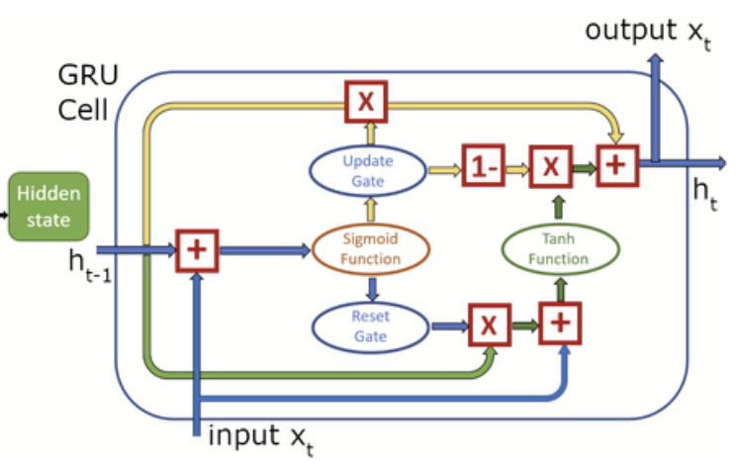
GRU
In TGN, the GRU (Gated Recurrent Unit) serves as a memory updater that captures temporal dependencies from past network events. It processes incoming messages from neighboring nodes along with the current memory state to generate an updated memory representation. This allows nodes to retain long-term information, adapt to dynamic changes, and make predictive decisions for tasks.
A GRU cell consists of three main components:
Reset Gate (r_t):
Role : Determines how much of the previous hidden state to forget.
Function : rt=σ(Wr⋅[ht−1,xt])
Calculation : Helps decide what information from the past is irrelevant to the current state.
Update Gate (z_t)
Role :Decides how much of the previous hidden state to retain and how much new information to add.
Function : zt=σ(Wz⋅[ht−1,xt])
Calculation : Balances between retaining past information and incorporating new information.
Candidate hidden state (ht)
Role :Computes a new hidden state based on current input and previous hidden state filtered by the reset gate.
Function : h~t=tanh⁡(W⋅[rt⊙ht−1,xt])
Calculation : Represents the potential new state of the GRU, considering both past and present information.
4. Final hidden state calculation
The final hidden state htht is calculated by combining the previous hidden state and the candidate hidden state, using the update gate to control the balance:
ht=(1−zt)⊙ht−1+zt⊙h~t

Slide 20
Functional time encoding

Slide 21
TEMPORAL GRAPH ATTENTION LAYER

Slide 22
EXTENSION TO INCORPORATE EDGE FEATURES

Slide 23
TEMPORAL SUB-GRAPH BATCHING

Slide 24
Comparison

Slide 25
Experiment and Results

Slide 26
Application use cases

Slide 27
Future work

